Slide 1
KP Seal Reconfirmation Report
Week 34 - 19th August 2020

Slide 2
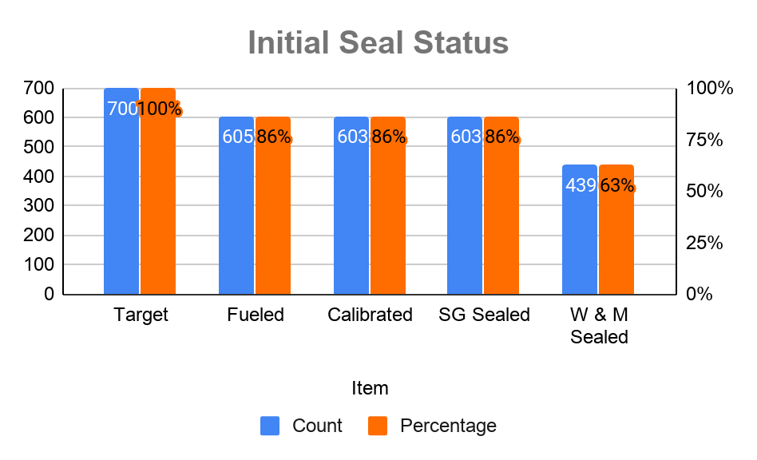
Initial Seal Status of Commissioned KOKOpoints
Summary
Calibrated KOKOpoints at the field are 603 out of fueled 605 fueled KOKOpoints.
KOKO Rivaan Office (Not Calibrated)
Demo Truck (Not Calibrated)
600 KOKOpoints were sealed by System group Limited.
KOKO Rivaan Office
Demo Truck
439 KOKOpoints were verified and sealed by Weights and Measures
Source Data

Slide 3
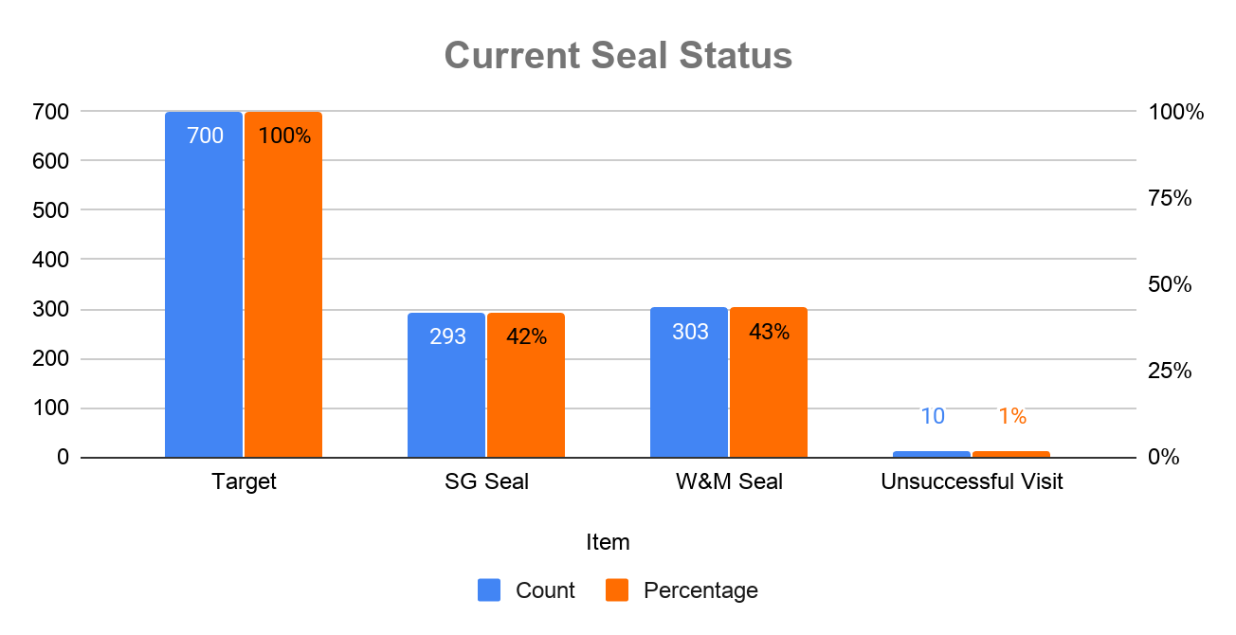
Current Seal Status of Commissioned KOKOpoints
Summary
293 KOKOpoints had seal on either Calibration PCB or Flowmeter or Both
303 KOKOpoints had seal on either Calibration PCB or Flowmeter or Both
10 KOKOpoint had Unsuccessful visit due to;-
Shop Closed
Decommissioning
Source Data

Slide 4
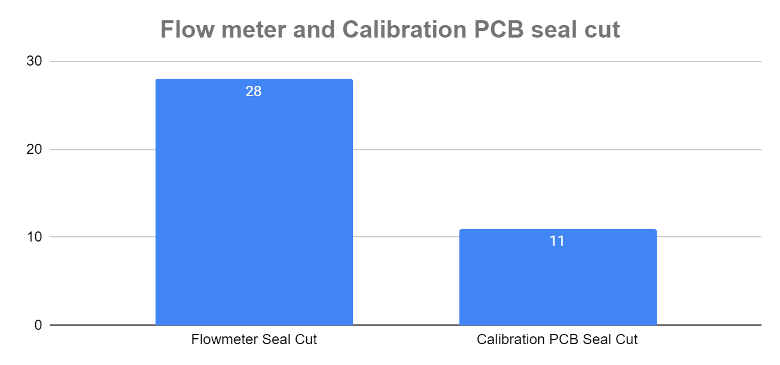
Flowmeter and Calibration PCB Seal cut status
Summary
28 KOKOpoint had seal cut (Both W&M and SG Seal) on Flowmeter.
11 KOKOpoint had seal cut (Both W&M and SG Seal) on Calibration PCB.
Source Data

Slide 5
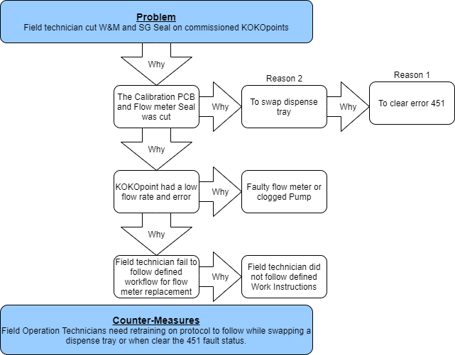
Cause (Why Analysis)
Flow Meter Replacement Process

Slide 6
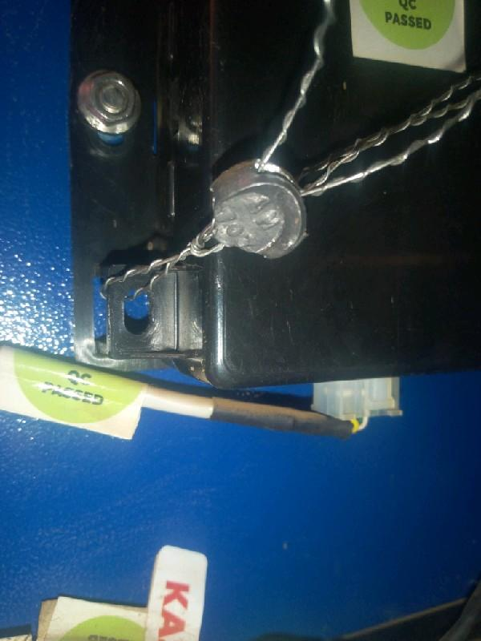
Further Investigation/Observation
Part Swapped
The total number of the cut seal on calibration PCB and flowmeter are 39 out of the confirmed sealed 596 KOKOpoints. From the defective sheets below are the summary of the parts that were swapped:-
KA45 Dispense tray - 19
KA29S Calibration PCB - 1
KA27 Below Left PCB - 2
Seal Tempering
Several Calibration PCB and Flow meter Seal were tempered then pressed by a plier.
Source Data

Slide 7
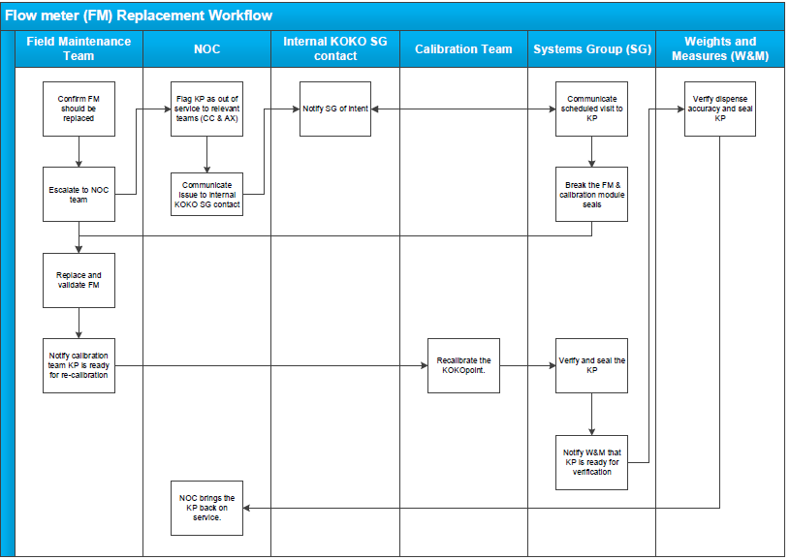
Flow Meter Replacement Process
Flow Meter Replacement Process

Slide 8

Thank you

